Slide 1
SERVICE GROUP (NY), Inc.
the
AL
Material Recovery Specialists
177 Wales Ave.
Tonawanda NY 14174

Slide 2
HISTORY
INCORPORATED IN 1985
INITIALLY IN THE HAZARDOUS MATERIAL HANDLING, TRANSPORTATION AND DISPOSAL SERVICES
OTHER SERVICES ADDED INCLUDING REMEDIATION, RECYCLING AND SPECIAL WASTE HANDLING (I.E. RAD, MERCURY, LAB PACK)
FOUNDED AMERICAN RECYCLERS CO. AND HAZMAN
TODAY OUR THREE BRANCHES PROVIDE A FACILITY FOR STORAGE, CONSOLIDATION OF WASTE AND RECYCLABLE MATERIALS

Slide 3
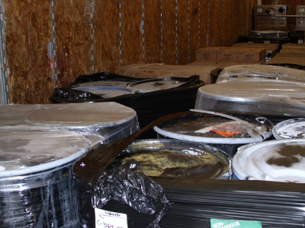
SERVICES
RECYCLING
AUDIT
PROGRAM DEVELOPMENT
IMPLEMENTATION
LAB CHEMICAL PACKAGING AND HANDLING
MATERIAL PACKAGING AND MANIFESTING
BULK LIQUID TRANSPORTATION
DRUM HANDLING AND TRANSPORTATION
SPILL CLEAN-UP
SITE REMEDIATION

Slide 4
RECYCLING PROGRAM (1 OF 2)
AUDIT
CRADLE TO GRAVE ANALYSIS
PROCESS FLOW CHARTING
CHARACTERIZATION AND QUANTIFICATION OF MATERIALS
PROGRAM DEVELOPMENT
COMPANY OBJECTIVES
PROCESS EVALUATION / RECOMMENDATION
PURCHASING – WHAT AND HOW MUCH
PROCESS IMPROVEMENTS / WASTE REDUCTION
RE-USE, RECYCLING AND ENERGY CREATION
SELECTION AND PRIORITIZATION OF TARGETS
SEGREGATION AND CONSOLIDATION
MATERIAL MARKETING AND FINAL DEPOSITION
FINANCIAL FEASABILITY
SCHEDULE AND MILESTONES

Slide 5
RECYCLING PROGRAM (2 OF 2)
IMPLEMENTATION
OBJECTIVES AND GOALS
PURCHASING OF INFRASTRUCTURE (IF NEEDED)
VENDOR SELECTION
SET-UP
TRAINING
COMMUNICATION AND FEEDBACK
PROGRAM MANAGEMENT
PROGRAM MONITORING
DATA COLLECTION AND TABULATION
MONITORING AND CONTROL
FEEDBACK
ADJUSTMENTS
ROUTINE REPORTING TO MANAGEMENT

Slide 6
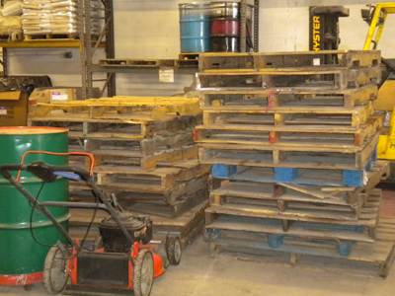
TYPICAL MATERIALS HANDLED
ELECTRONICS / FIXTURES / LIGHTING
OFF SPEC / SHELF LIFE PRODUCTS
PACKAGING
PAPER FIBER
PALLETS
METALS
OILS / COOLING WATERS
EXCESS PRODUCTION MATERIALS
HAZARDOUS MATERIALS

Slide 7
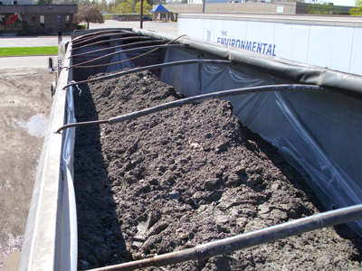
INDUSTRIAL SERVICES (1 OF 2)
LAB-PACKS
CHARACTERIZATION
PRICING AND HANDLING OPTIONS
CONSOLIDATION
TRANSPORTATION
BULK MATERIALS
ON-SITE CONSOLIDATION
BULK LOAD TRANSPORTATION (LIQUIDS/SOLIDS)
TRACTOR/TRAILER
VAC TRUCK
BOX TRUCK
LTL’S

Slide 8
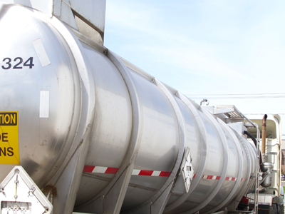
INDUSTRIAL SERVICES (2 OF 2)
FACILITY SERVICES
TANK CLEANING
CBS/PBS INSPECTION AND CERTIFICATION
HIGH PRESSURE WASHING
WASTE MANIFESTING, TRANSPORTATION AND DISPOSAL
ASBESTOS ABATEMENT
REMEDIATION
INVESTIGATION
DESIGN/WORK PLAN PREPARATION
REMEDIAL CONSTRUCTION
FINAL REPORTING AND REGULATORY CLOSE-OUT

Slide 9
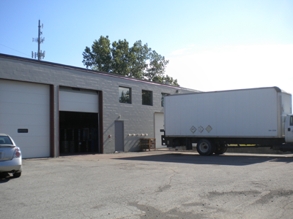
ARC – AMERICAN RECYCLERS CO.
FACILITY LOCATED AT 177 WALES AVE. TONAWANDA, N.Y.
FULLY PERMITTED NON-HAZARDOUS MATERIALS TRANSER FACILITY
ACCEPTS CAPACITY OF 150 TONS PER DAY
SORTING AND SEGREGATION OF RECYCLABLE MATERIALS
TERMINAL FOR COLLECTION AND SHIPPING OF MATERIALS

Slide 10
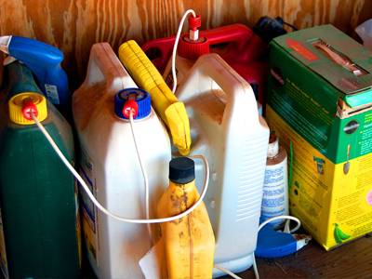
HAZMAN
WE SAW A NEED IN THE COMMUNITY AND FOR A HAZARDOUS WASTE DROP-OFF FACILITY
OPENED DECEMBER 1ST 2011
SQG AND HHW DROP-OFF LOCATION
SMALL BUSINESSES AND HOME OWNERS NOW HAVE AN ENVIRONMENTALLY SOUND PLACE FOR THEIR SMALL QUANTITY AND HOUSEHOLD HAZARDOUS WASTE

Slide 11
PRICING
UP-FRONT FEE FOR AUDIT AND PROGRAM DEVELOPMENT
IMPLEMENTATION AND REPORTING FEE BUILT INTO UNIT PRICE COST FOR HANDLING AND MATERIAL RECYLCING
STANDARD FEES FOR MATERIAL HANDLING AND DISPOSAL ARE ALSO AVAILABLE

Slide 12
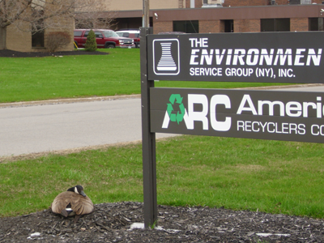
SUMMARY
ESG PROVIDES A HOST OF MATERIAL MANAGEMENT ALTERNATIVES
OUR PROGRAMS CAN BE TAILORED TO YOUR NEEDS AND OBJECTIVES
ESG’S PRIMARY OBJECTIVE IS TO MEET THE GROWING NEED TO HANDLE EXCESS MATERIALS IN A ENVIRONMENTALLY AND SOCIALLY SOUND MANNER.
TOGETHER ESG, ARC, AND HAZMAN PROVIDE A ONE-STOP SHOP FOR RECYCLABLE PRODUCTS AND WASTE CONSOLIDATION
NO JOB IS TOO BIG OR TOO SMALL!

Slide 13
CONTACT US
177 Wales Ave.
Tonawanda, NY 14150
PH: (716) 695-6720
FX: (716) 695-0161
www.esgenv.com
www.arcgg.com
www.hazmanusa.com

